Slide 1
Biological Computation in Neurons and Networks
Functional Models
Michael J Berry II
Thursday, June 28, 2012

Slide 2
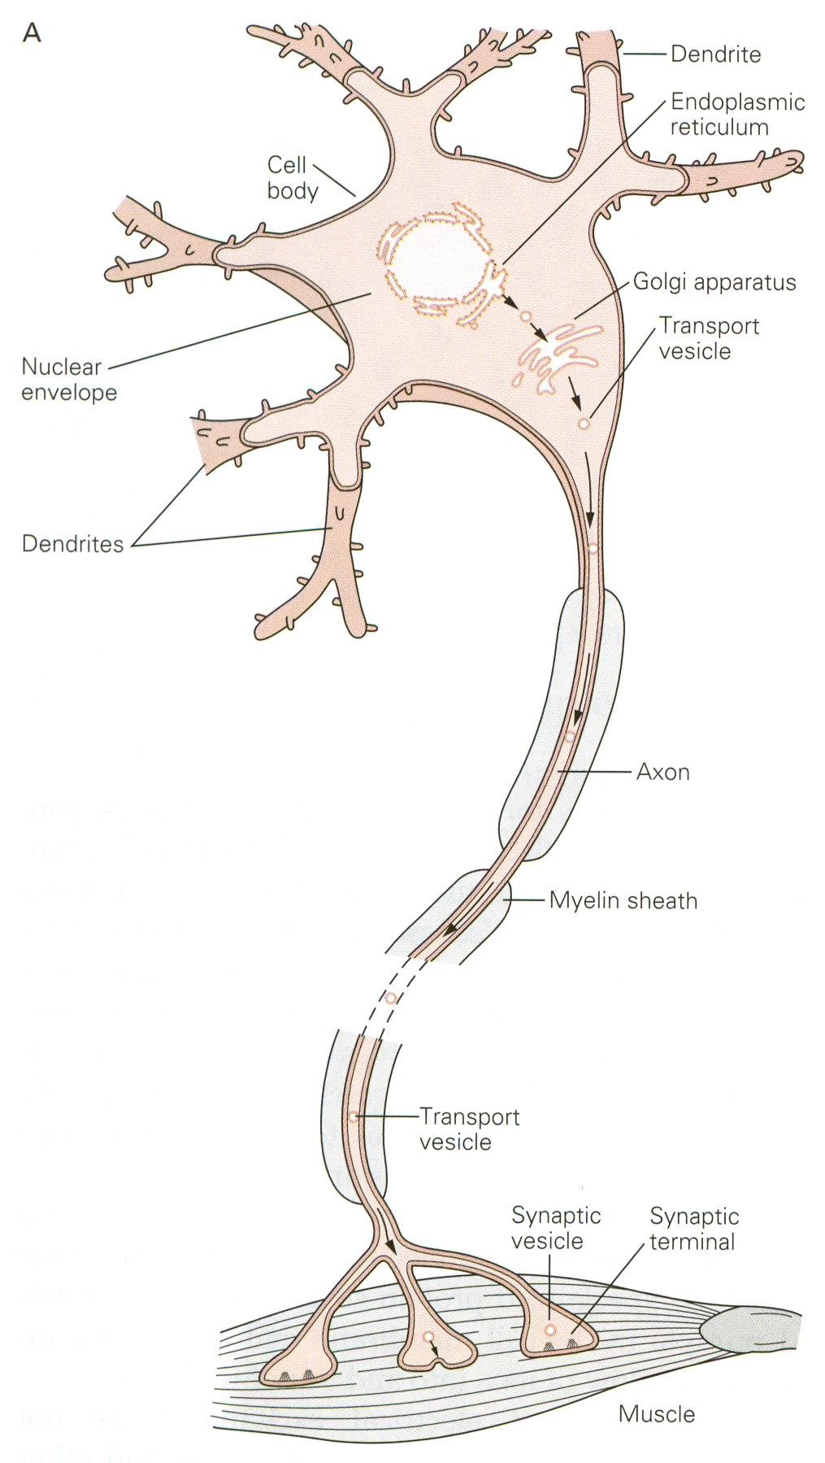
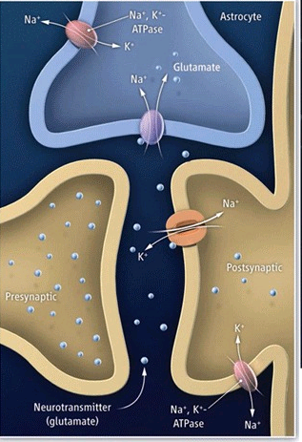
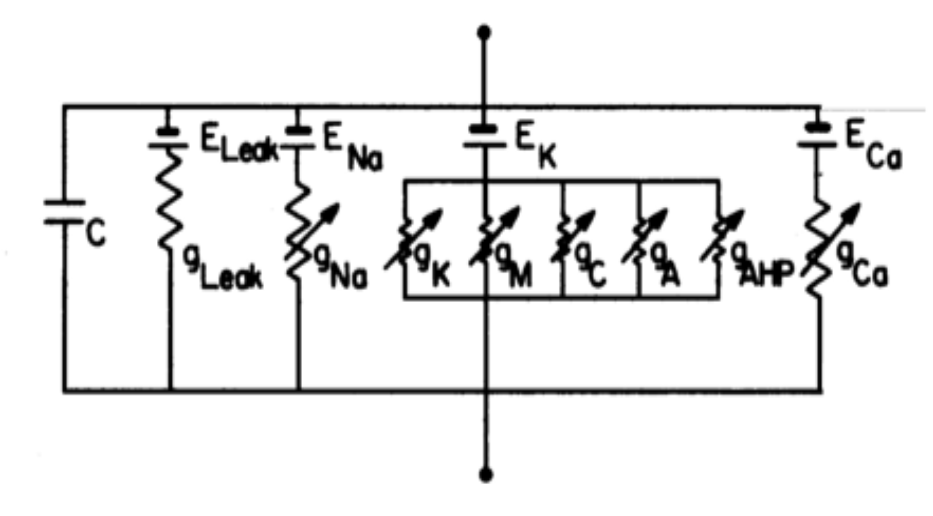
Mechanistic Models of Neural Networks
• Equivalent circuit model • Synaptic transmission and plasticity
➔

Slide 3
Many Parameters
• Voltage-gated K⁺
• Voltage-gated Na⁺
• Other channels, synaptic dynamics …
Another Approach: Phenomenological Models

Slide 4
OUTLINE
• Tuning Curves
• The Linear-Nonlinear (LN) Model
• The Spike-Triggered Covariance Model
• Models with a Refractory Spiking Process

Slide 5
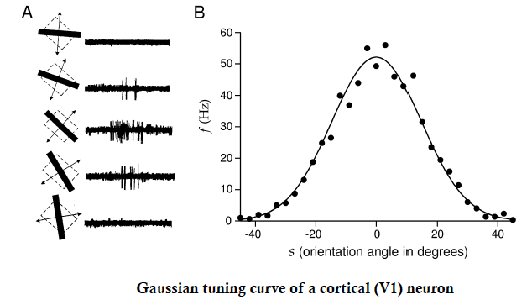
Receptive Fields and Tuning Curves
• tuning curve: r = f(s)

Slide 6
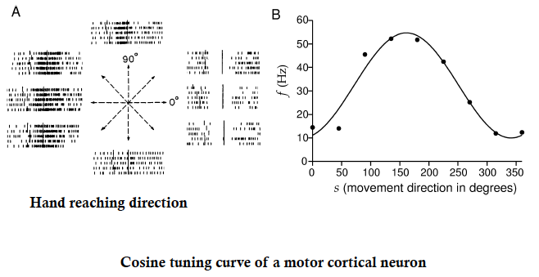
Receptive Fields and Tuning Curves II
• tuning curve: r = f(s)

Slide 7
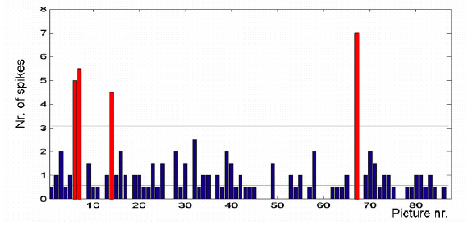
Higher brain areas represent increasingly complex features
• human epilepsy patients: awake, behaving
• medial temporal lobe
• present different pictures, measure spiking response

Slide 8
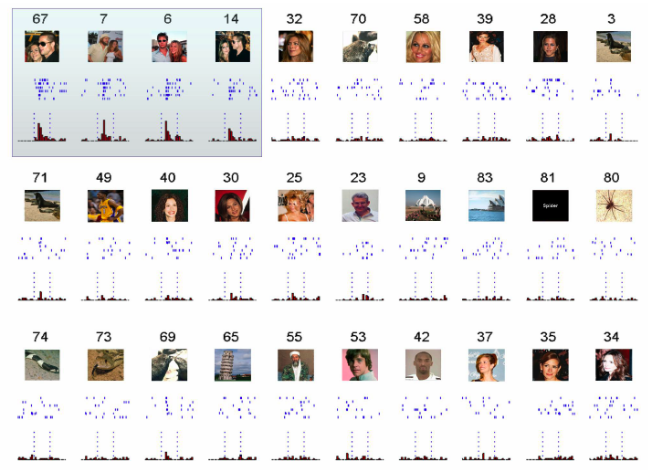

Slide 9
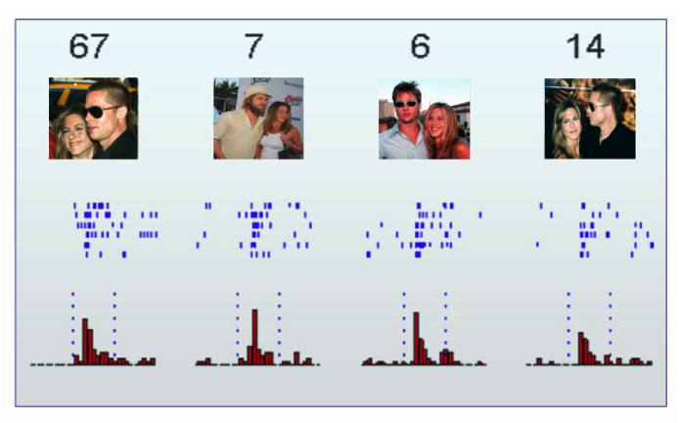
Common Stimulus

Slide 10
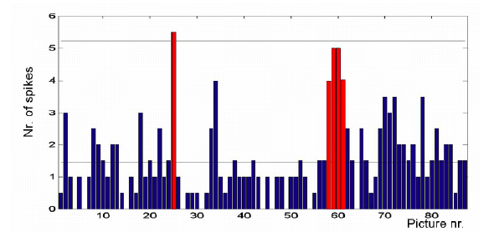
Another Cell

Slide 11
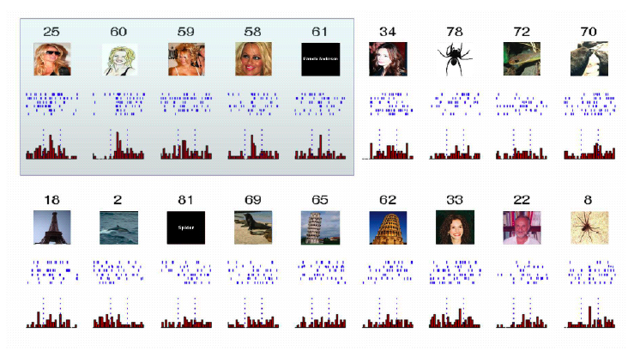
Another Cell: Stimuli

Slide 12
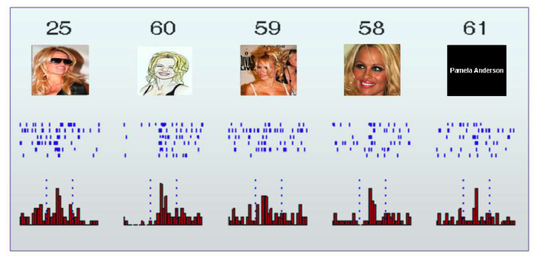
Common Stimuli

Slide 13
Inadequacy of Tuning Curves
• Provides insight into neuronal function, spatial maps
• What if there is a stimulus outside of the test set?
– want a model that can predict response to an arbitrary stimulus
• What about the dynamics of the response?
• What about spike times?
• What about a stimulus with dynamics?

Slide 14
OUTLINE
• Tuning Curves
• The Linear-Nonlinear (LN) Model
• The Spike-Triggered Covariance Model
• Models with a Refractory Spiking Process

Slide 15
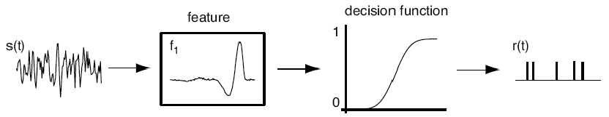
LNP Model of Neural Function
• Allows time-varying stimulus
• Predicts time-varying firing rate
• Converts time-varying firing rate into a spike train

Slide 16
Linear Response: Example

Slide 17
Linear Response: Example cont.

Slide 18
Linear Response: Example cont.

Slide 19
LN Model: Applying the Nonlinear Function

Slide 20
Key Property of the LN Model
• If the stimulus is white noise…
then the linear filter is the spike-triggered stimulus average:
• Arises from symmetry in the stimulus ensemble (Chichilnisky)
• Implies that you measure all these parameters from data

Slide 21
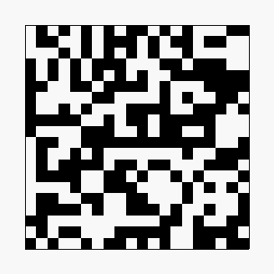
Measuring the Receptive Field
• Reverse correlation to a flickering checkerboard

Slide 22
The Receptive Field
• Example from a retinal ganglion cell
Spatial Profile
Temporal Profile

Slide 23
Finding the Nonlinear Function
• Convolve the linear filter with the stimulus:
• Find the distribution of effective stimulus values at spike times:
• Invert using Bayes’ Rule:

Slide 24
The LN Model
1) Find the spike-triggered stimulus average (STA)
2) Linear filter must be time-reversed STA
3) Find the effective stimulus, s₁(t)
4) Sample s₁(t) at the times of spikes
5) Use Bayes’ Rule to find the nonlinear function

Slide 25
Poisson Processes
• Converts time-varying firing rate to a spike train:

Slide 26
Properties of the Poisson Process
• Mean spike count:
• Variance of the spike count:

Slide 27
OUTLINE
• Tuning Curves
• The Linear-Nonlinear (LN) Model
• The Spike-Triggered Covariance Model
• Models with a Refractory Spiking Process

Slide 28
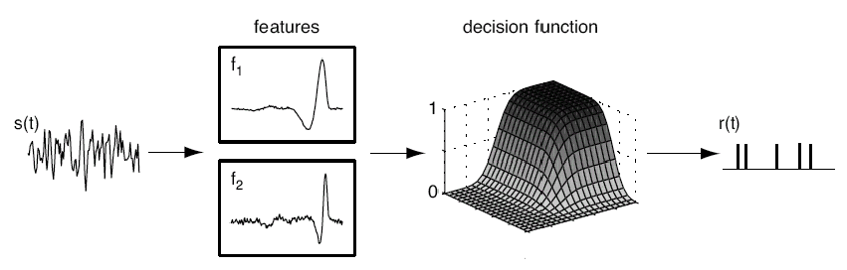
Model of Neural Representation
• what if the LN model is inadequate?
• generalization to more complex dependence on stimulus

Slide 29
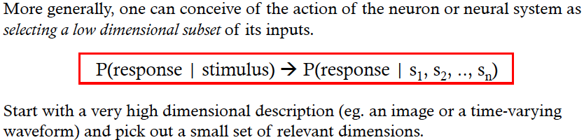
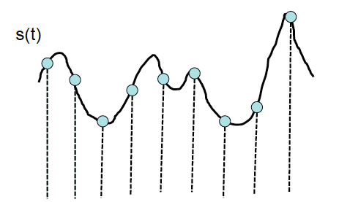
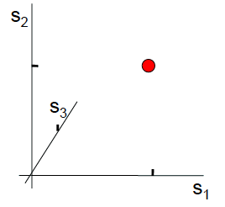
Dimensionality Reduction

Slide 30
Linear Response: Convolution = Vector Projection
• Algebraic vs. Geometric pictures:

Slide 31
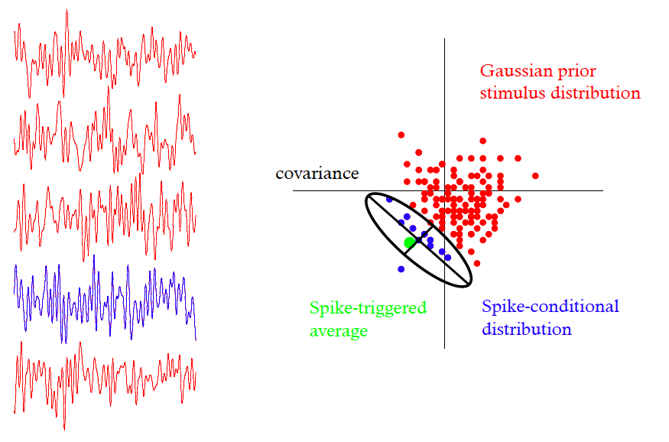
Determining linear features from white noise

Slide 32
Identifying Multiple Stimulus Features
• Calculate the covariance matrix:
• Subtract off the stimulus covariance in the prior distribution:
Spike-triggered stimulus covariance
Spike-triggered stimulus average

Slide 33
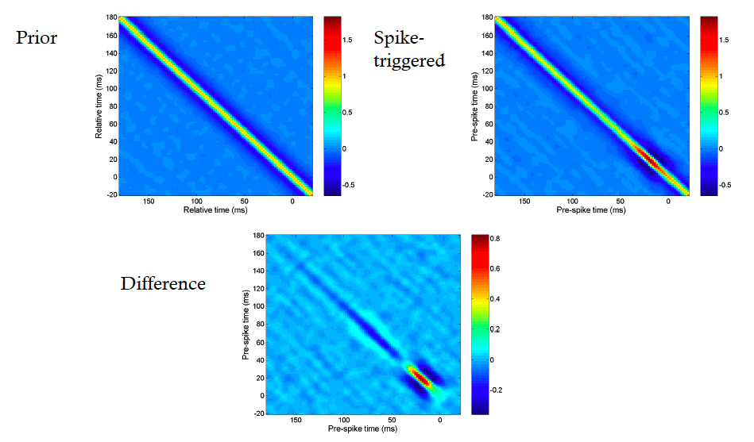
Covariance Analysis

Slide 34
Identifying Multiple Stimulus Features II
• Diagonalize the covariance matrix
• Look at the spectrum of eigenvalues:
– the number of eigenvalues that are significantly different from zero is the number of stimulus features that affect the neuron’s spiking
– the corresponding eigenvectors are the relevant stimulus features (or span the relevant stimulus subspace)

Slide 35
Back to the Neural Model
• multiple stimulus features from significant eigenvalues
• linear filtering = convolution = projection

Slide 36
Summary
• Building coding models using the correlation
between stimulus and response
• More detailed analysis of this correlation
yields richer, more accurate models
• Problem sets will explore how to build such models

Slide 37
OUTLINE
• Tuning Curves
• The Linear-Nonlinear (LN) Model
• The Spike-Triggered Covariance Model
• Models with a Refractory Spiking Process

Slide 40
Actual Noise in the Spike Count
• Variance is much lower than the mean
• Variance approaches the lower bound for many events

Slide 41
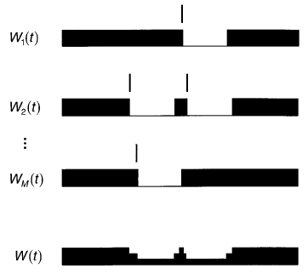
Role of the Refractory Period
• Firing rate depends on time of last spike:
Berry & Meister, J. Neurosci. 1998

Slide 42
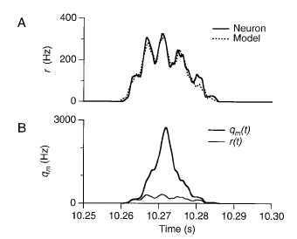
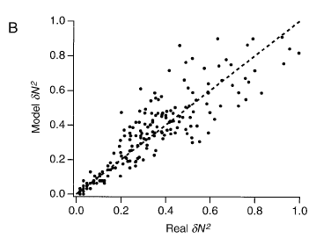
Results for Refractory Neurons
• Can match non-Poisson spiking statistics:

Slide 43
The END

